Slide 1
CLASSIFYING SHOOTING INCIDENT FATALITY
BORSE JATIN D.

Slide 2
Agenda
INTRODUCTION
DATA GATHERING & DATA PREPROCESSING
EXPLORATORY DATA ANALYSIS (EDA)
FEATURE ENGINEERING AND SELECTION
MODEL TRAINING
MODEL EVALUATION
CONCLUSION & FUTURE SCOPE

Slide 3
INTRODUCTION
Project Aim:
To develop a machine learning model that classifiers historical shooting incidents as fatal or non-fatal , helping predict
future outcomes based on incident data.
Context:
The project supports law enforcement agencies by offering data-driven insight to:
Improve their response strategies.
Prioritize high-risk areas for resource deployment.
Enhance overall public safety measures.

Slide 4
DATA GATHERING & DATA PREPROCESSING
Data Source :
Dataset : NYPD Shooting Incident Data (Historic)
Import Dataset : pandas.read_csv()
Target Variable: STATISTICAL_MURDER_FLAG (TRUE = Fatal, FALSE = Non-Fatal)
Data Cleaning :
Replaced invalid/missing values in:
-PERP_AGE_GROUP, PERP_SEX, PERP_RACE, VIC_AGE_GROUP Used "UNKNOWN" as a common category for missing/ambiguous data
Dropped rows with remaining null values using dropna()
Unnecessary columns dropped

Slide 5
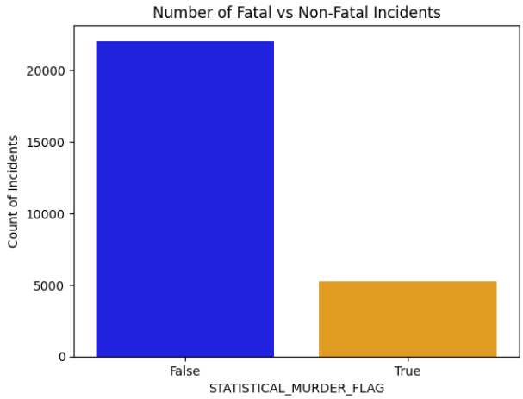
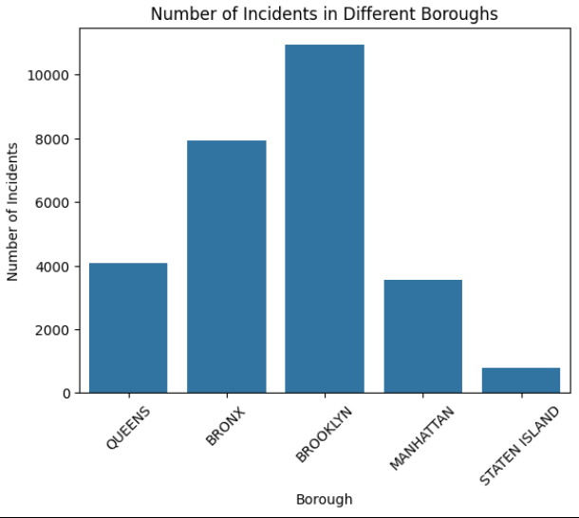
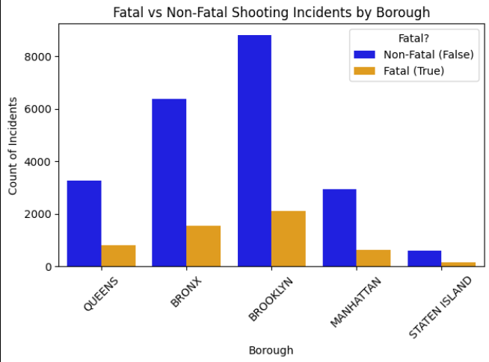
EXPLORATORY DATA ANALYSIS (EDA)
1. Distribution Insights :
Fatal vs Non-Fatal Incidents
Incidents by Borough
Fatal vs Non-Fatal Incidents
This graph shows the comparison between fatal and non-fatal shooting incidents using the 'STATISTICAL_MURDER_FLAG' column. It helps identify class imbalance in the data.
2. Incidents by Borough
This bar chart shows the total number of shooting incidents reported in different boroughs.
This chart compares the number of Fatal (True) and Non-Fatal (False) shooting incidents across each borough.

Slide 6
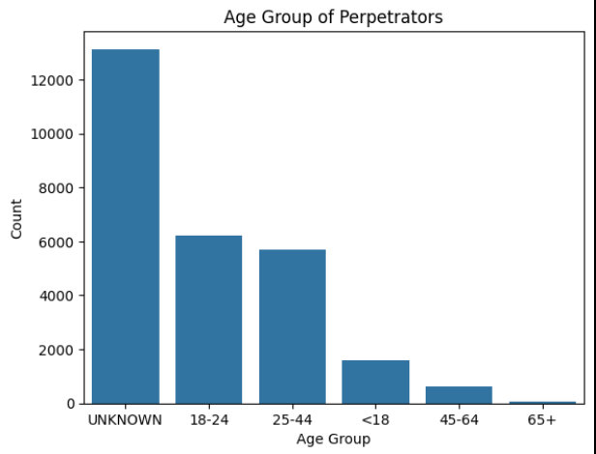
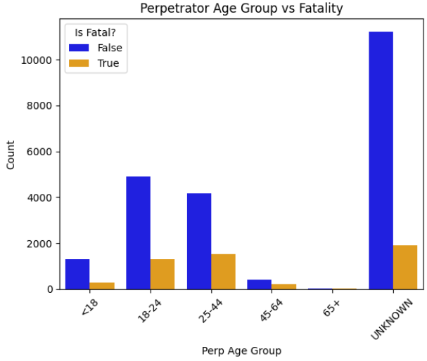
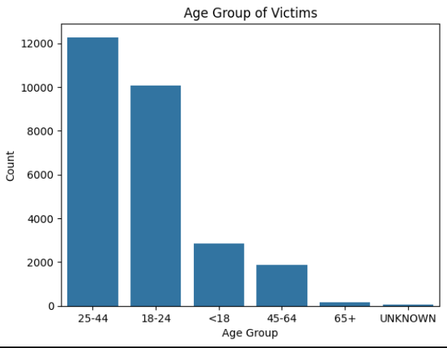
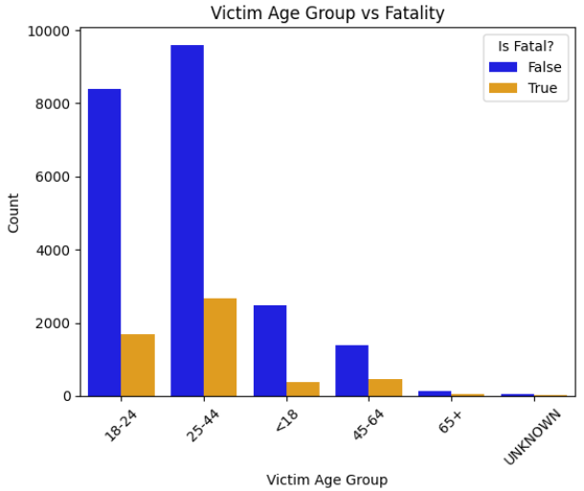
Demographic Analysis
Perpetrator Age Group
Victim Age Group
Perpetrator Age Group
highest number of cases fall under the "UNKNOWN" age group, which may indicate missing or incomplete data.
In all age groups, the majority of incidents were non-fatal (blue).
2. Victim Age Group
Highest Victim Count: The age group 25-44 has the highest number of victims, indicating that this demographic is most affected.

Slide 7
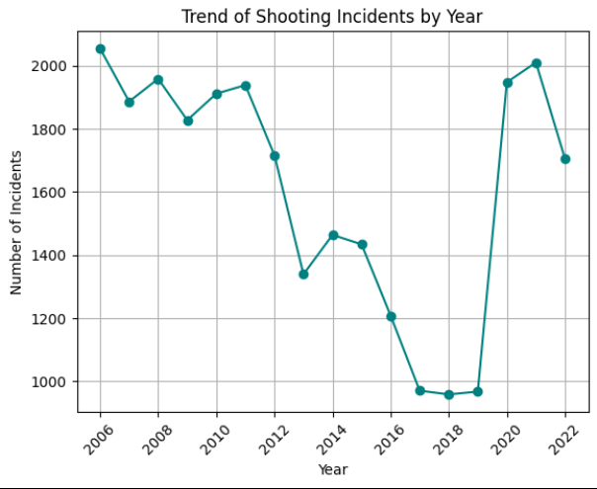
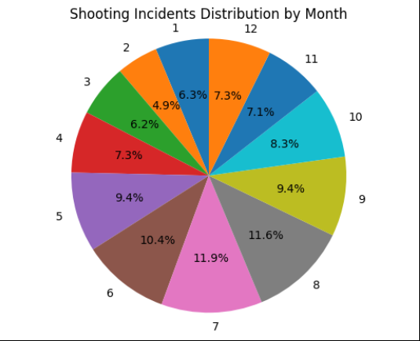
Time & Trends
Incidents by Year (Line chart)
Monthly Distribution (Pie chart)
1. Incidents by Year (Line chart)
Steady increase in shootings from 2006 (~1000) to 2022 (~2000)
2. Monthly Distribution (Pie chart)
Clear seasonal trend with summer violence spike

Slide 8
FEATURE ENGINEERING & SELECTION
Feature Creation :
Extracted time-based features from OCCUR_DATE :
Created new columns : YEAR, MONTH, DAY
Label Encoding :
Converted categorical text data to numerical :
PERP_SEX, PERP_AGE_GROUP, VIC_SEX, VIC_AGE_GROUP using LabelEncoder
One-Hot Encoding:
Applied on :
BORO, PERP_RACE, VIC_RACE, TIME_PERIOD
Used pd.get_dummies() with drop_first=True to avoid dummy variable trap.
Feature Selection & Target Definition
Target Variable (y) : STATISTICAL_MURDER_FLAG
Feature (X) : All other columns after preprocessing

Slide 9


Model TRAINING
Training Process
Feature scaled using StandardScaler before training.
Train- Test Split :
80% data used for training, 20% for testing .
Model Used :
Logistic Regression
Random Forest Classifier

Slide 10
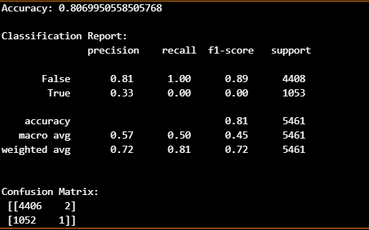
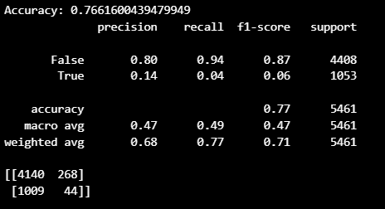
MODEL Evaluation
Evaluation Metrics Used
Accuracy Score: Overall correctness of model predictions
Confusion Matrix: Measures True Positives, False Positives, True Negatives, False Negatives
Classification Report: Precision, Recall, F1-Score
Logistic Regression 2. Random Forest Classifier
Accuracy: 0.81 Accuracy: 0.77

Slide 11
CONCLUSION & FUTURE SCOPE
Conclusion:
Successfully developed a Machine Learning model to classify shooting incidents as fatal or non-fatal.
Logistic Regression achieved the best performance with high accuracy and balanced precision-recall.
Identified key factors influencing fatality:
Borough
Time of incident
Victim/Perpetrator demographics
Model can support law enforcement with data-driven strategies for crime response and prevention.
Future Scope:
Add More Features: Include weather data, location type (indoor/outdoor), gang involvement, etc.
Use Deep Learning Models: Try Neural Networks for deeper pattern detection.
Real-Time Prediction System: Integrate the model with real-time data streams from police records.
Geo-Spatial Analysis: Use latitude/longitude to analyze and predict crime hotspots.
Dashboard Integration: Build a live dashboard using Power BI or Tableau for ongoing monitoring.
.

Slide 12
QUESTION

Slide 13
Thank You!

